Slide 1
ECG,PPG &PCG based estimation of blood pressure
Student ID
1406161 1406162 1406163

Slide 2
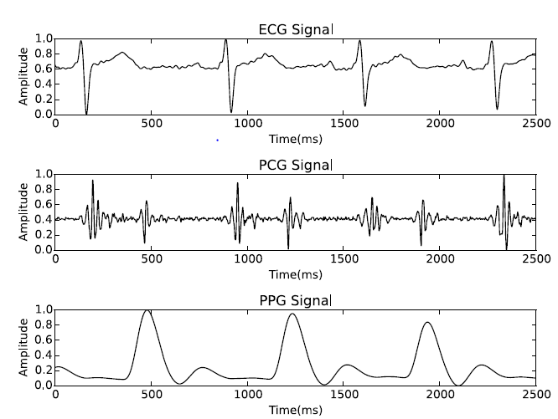
electrocardiogram (ECG)
photoplethysmogram (PPG)
phonocardiogram (PCG)
Force sensing resistor (fsr)

Slide 3
Non-invasive Blood Pressure Estimation(KAGGLE.COM) hTtps://www.kaggle.com/bguberfain/reading-and-showing-data/data
dataset
“UID”: Subject number
“age”: Age of the subject
“weight”: Weight of the subject (Kg)
“height”: Height of the subject (cm)
“data_PCG”: Acquired PCG signal from chest (Fs = 1 KHz)
“data_ECG”: Acquired ECG signal (Fs = 1 KHz)
“data_PPG”: Acquired PPG signal from fingertip (Fs = 1 KHz)
“data_FSR”: Acquired FSR signal (Fs = 1 KHz)
“data_BP”: reference systolic blood pressure (SBP) and diastolic blood pressure (DBP) values acquired from the subjects.

Slide 4
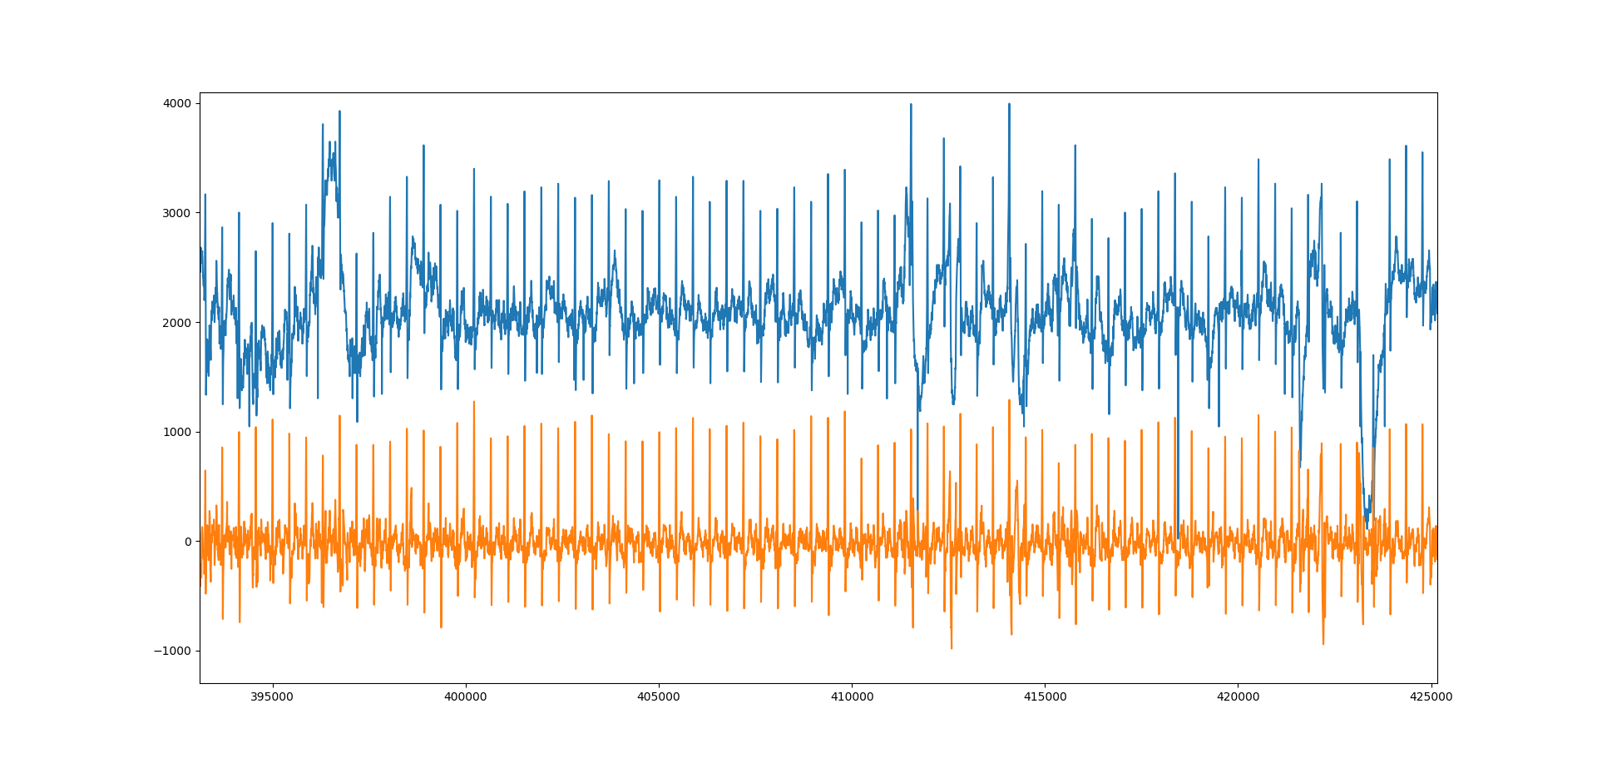
Ecg PRE-PROCESSING
PRE-PROCESSING
Removing Outliers, baseline wondering, low pass filter

Slide 5
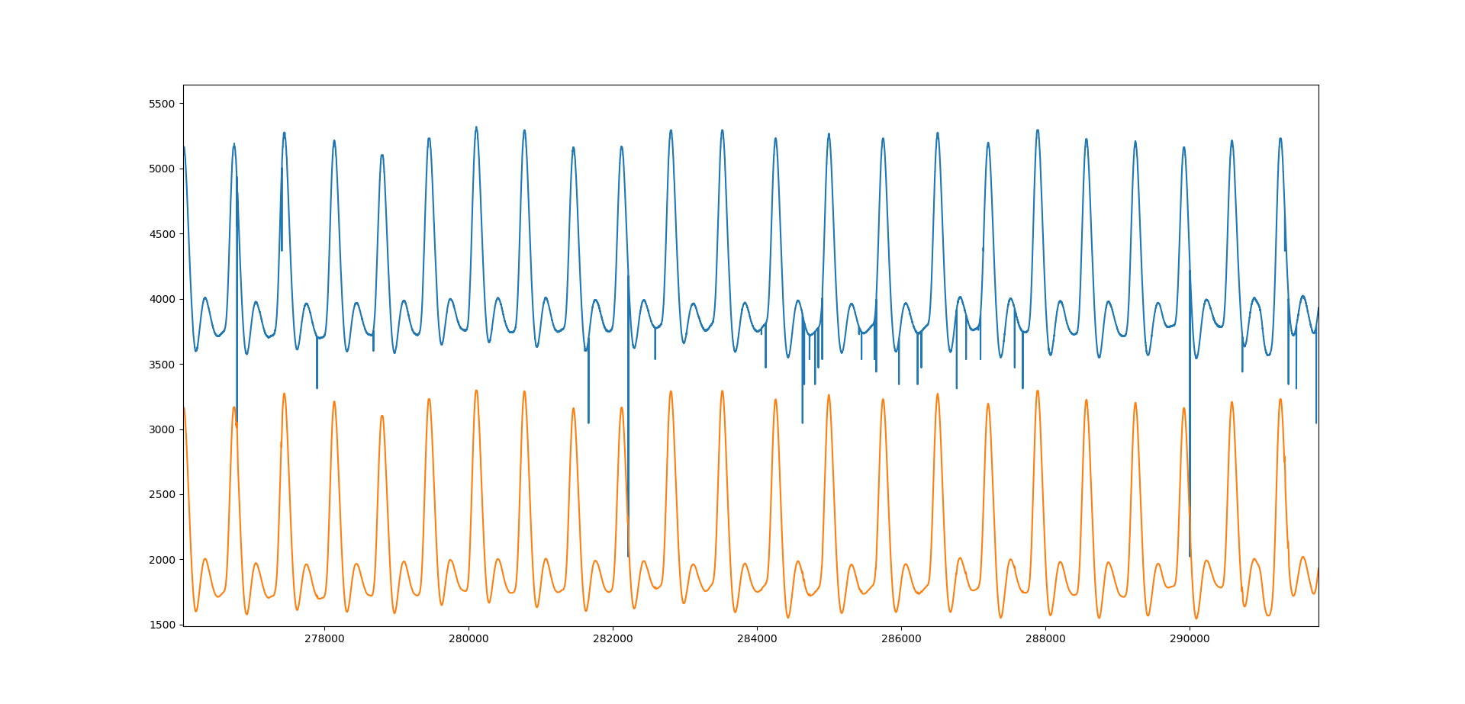
ppg PRE-PROCESSING
PRE-PROCESSING
Removing Outliers, low pass filter

Slide 6
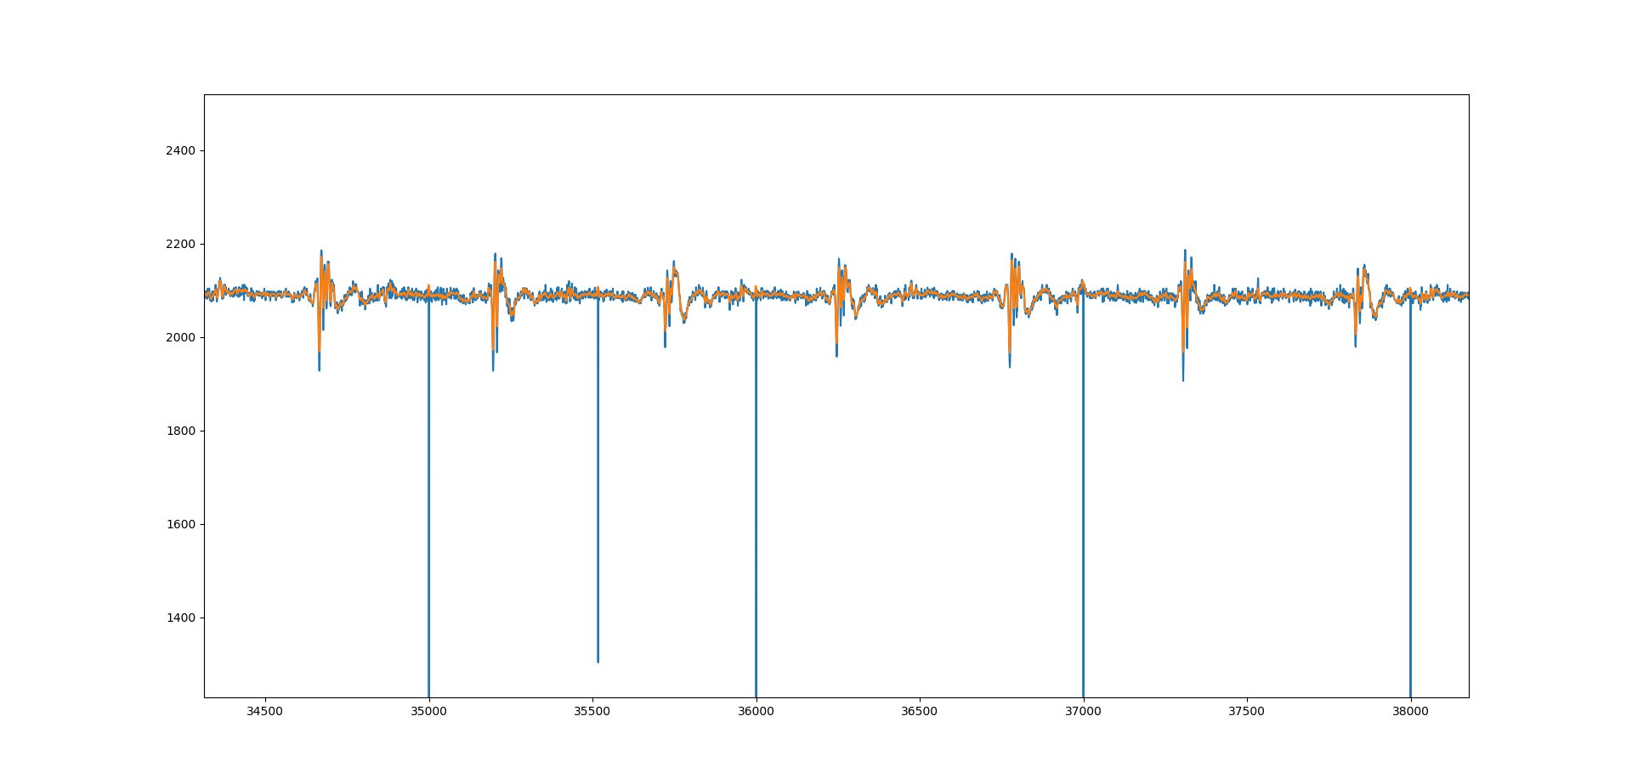
pcg PRE-PROCESSING
PRE-PROCESSING
Removing Outliers, low pass filter

Slide 7
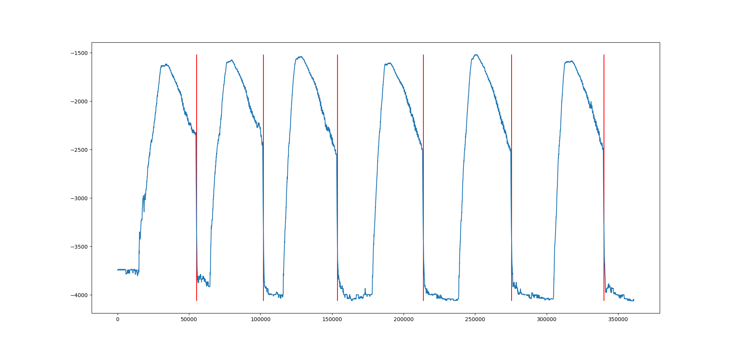
fsr PRE-PROCESSING
PRE-PROCESSING
Removing Outliers, low pass filter, window detection

Slide 8
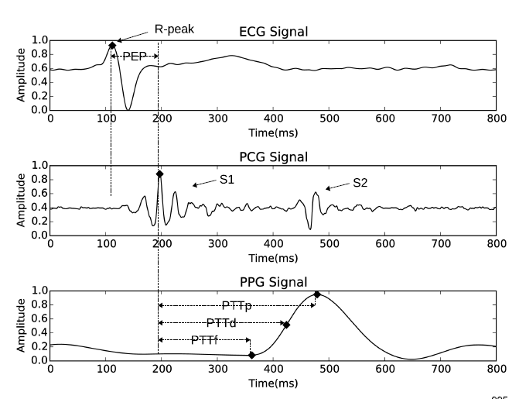
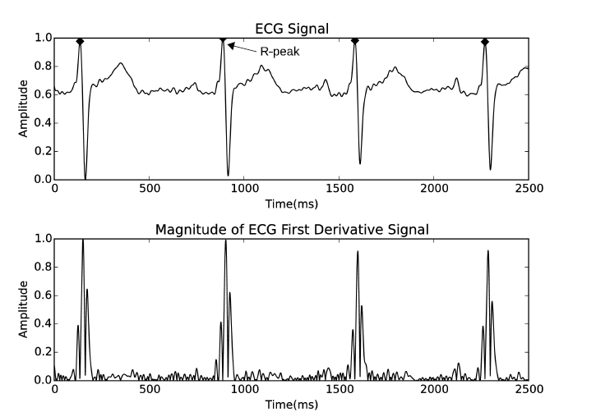
Features extraction
Ptt-p, ptt-d, ptt-f, pep, heart rate

Slide 9
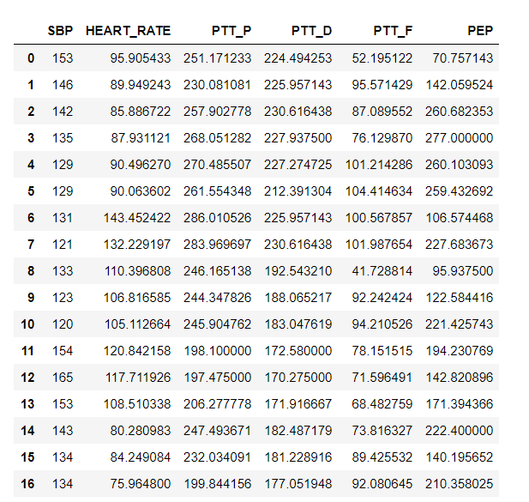
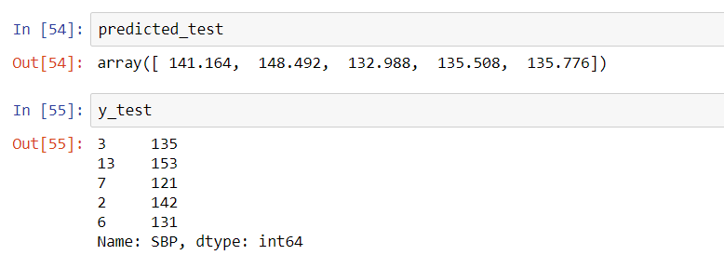

Random forest regression

Slide 10
Thank you

